Slide 1


Power Trust
Group 8
Srinidhi Kasireddy
Mounika Loka
Srinivas Varma Byraju
Manoj Kumar Kommi
Veera Venkata Naga Vardhani Patttem

Slide 2

Table of Contents
Introduction
Problem Statement
Importance of solving the Problem
Dealing with the problem
Analytics
Results
Recommendations
Conclusion

Slide 3
Introduction
PowerTrust being the pioneers of the climate, having many decades of combined experience in developing, financing, and operating the renewable energy projects and striving hard to provide the affordable electricity to millions of people around the world using renewables which are causing a greater positive social and climatic impact.
PowerTrust is helping the corporate climate leaders to shape the world through transformative solar projects and paying for the clean energy the clients generate. Powertrust focuses on catalyzing energy projects in rural areas with low energy access rates. We electrify hospitals, health care centers, schools, and small businesses.

Slide 4

Problem Statement
“Providing dashboards for PowerTrust from the amount of data generated from them by the business worldwide which are effective in providing valuable insights and actionable insights to stakeholders across different regions and industries.”

Slide 5




Why solving this problem is important?

Slide 6
Dealing with the problem
Data set analysis
Data preprocessing
Analytics

Slide 7

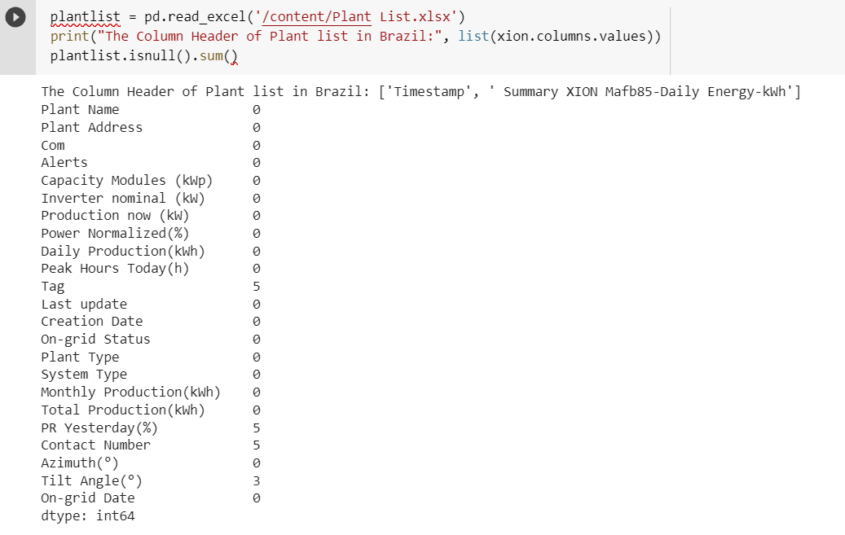
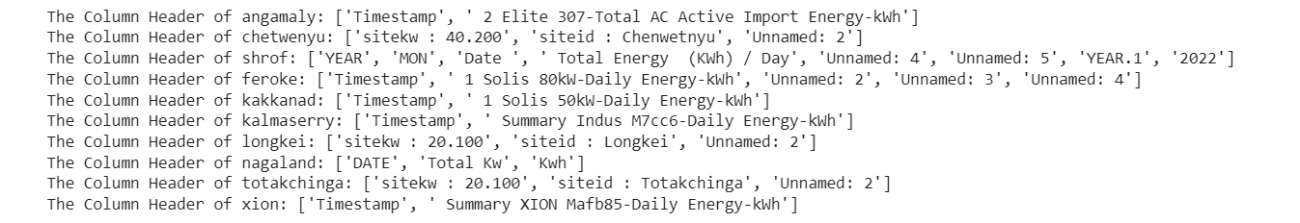
Dealing with the problem
Dataset Analysis:
Analysis of dataset provided is done on google collab with the use of python.

Slide 8
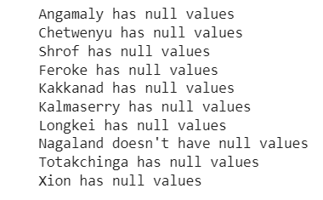
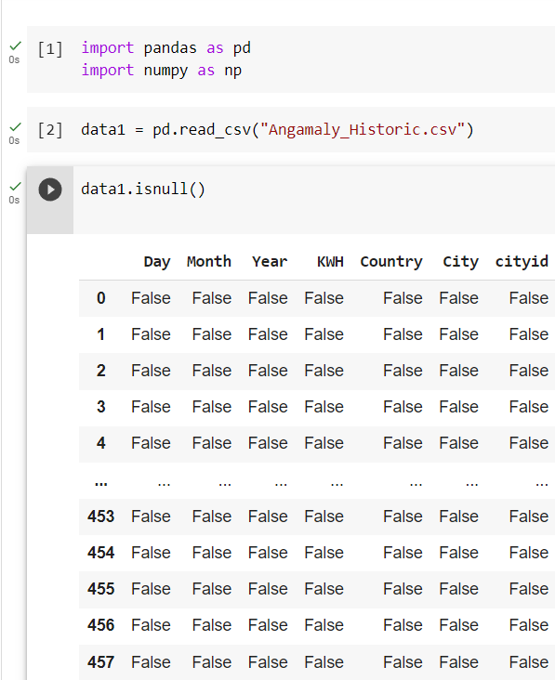
Dealing with the problem
Data Preprocessing:
Data Cleaning:
Removing null values

Slide 9
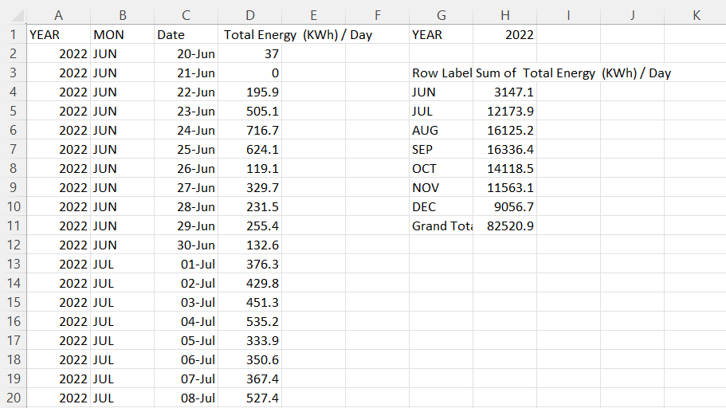
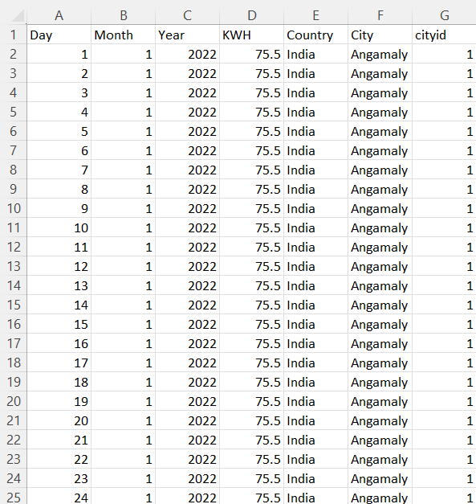
Dealing with the problem
Unstructured data
Structured data

Slide 10

Dealing with the problem
Analytics : We are using Power Bi for designing dashboards and extracting the insights.
Why Power BI:
Visualization.
Data Connectivity.
Real-Time Data.
Free to use.
Scalability.

Slide 11
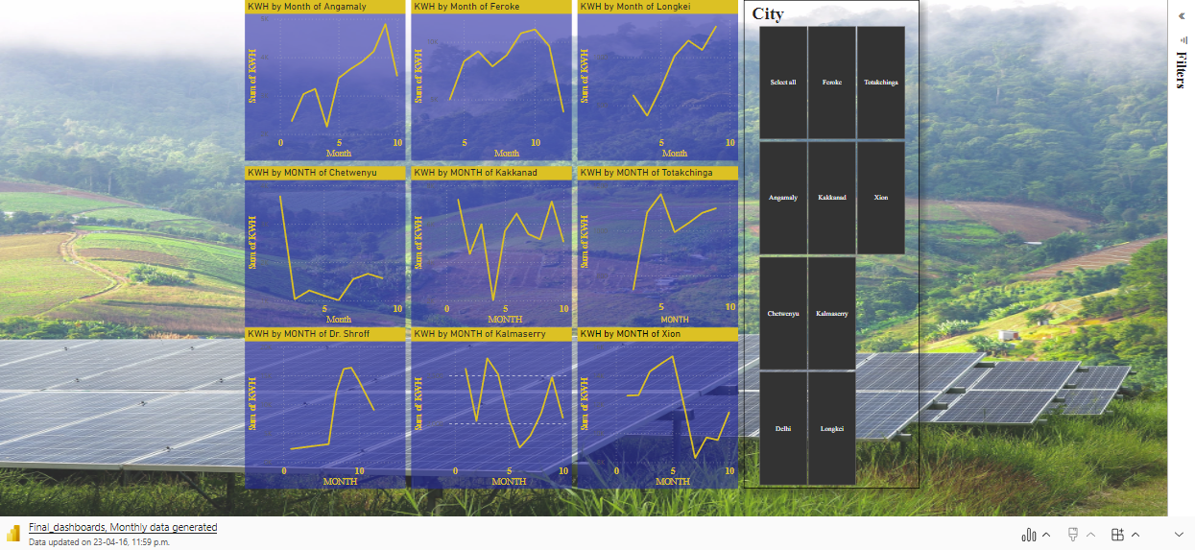
Monthly power production in Indian Cities

Slide 12
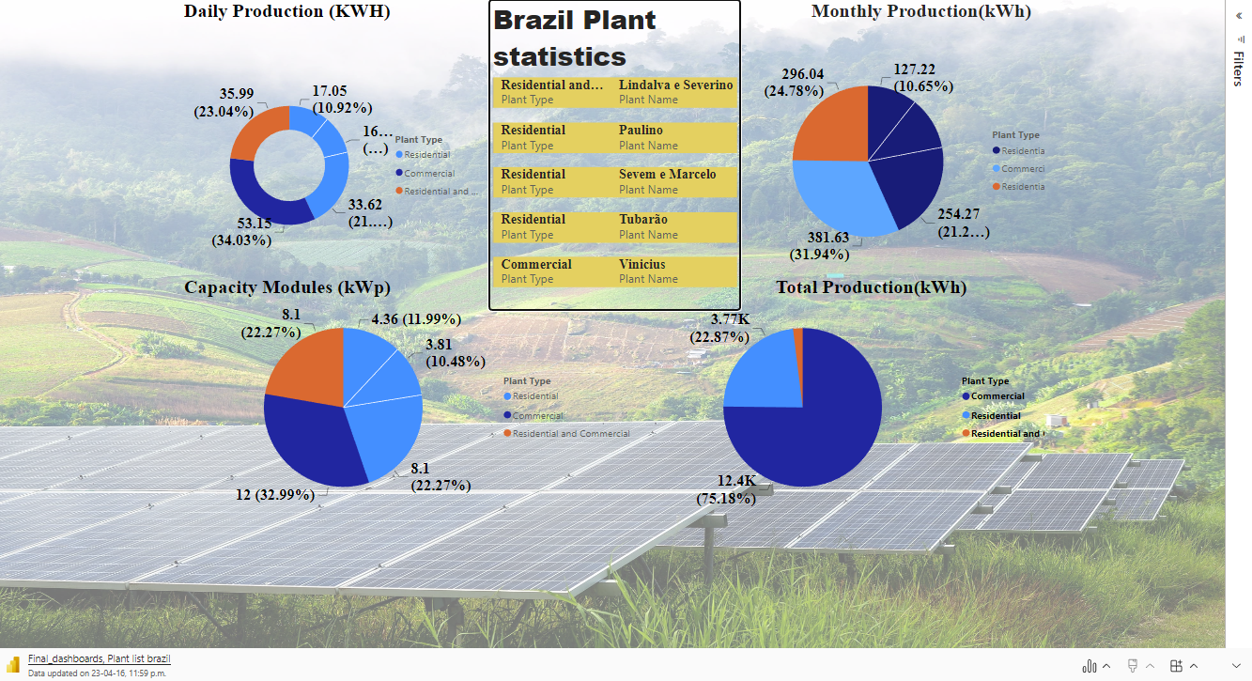

Slide 13
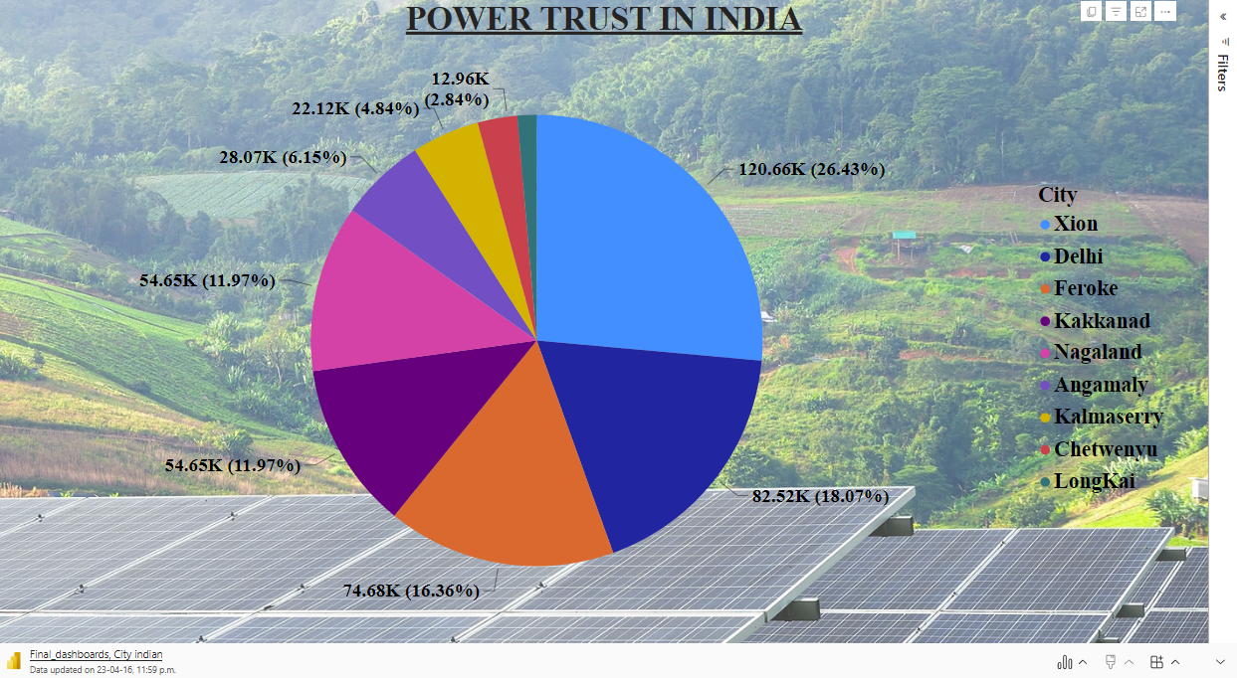

Slide 14
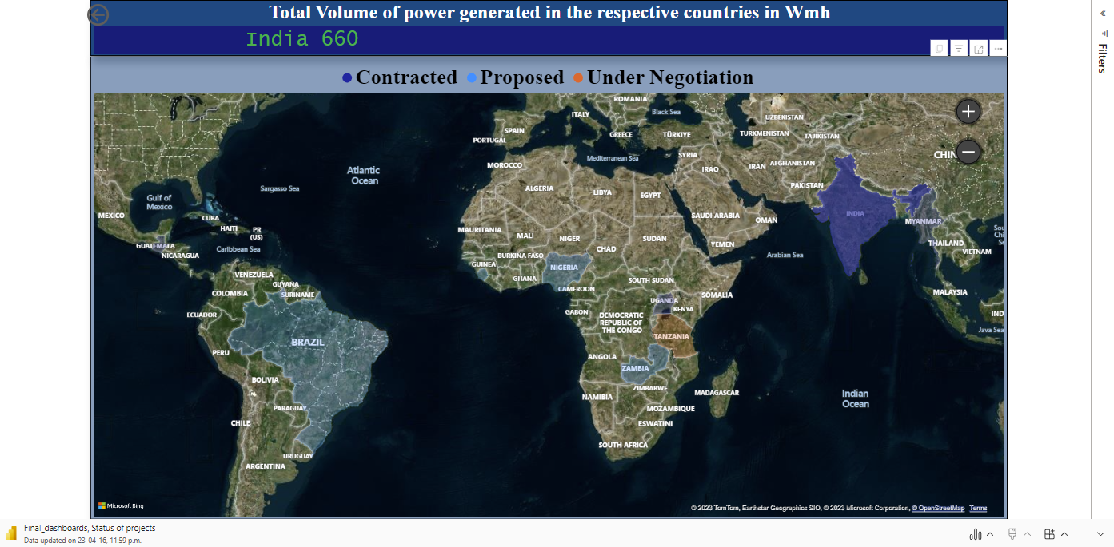

Slide 15
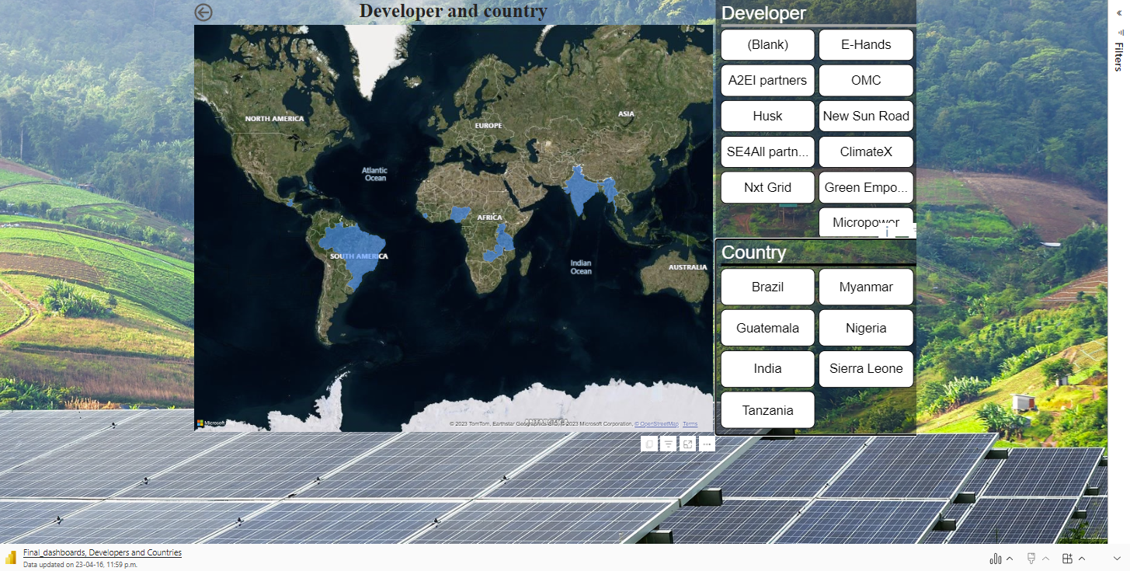

Slide 16
Analysis of Dashboards
Monthly electricity generation in Indian cities
This dashboard offers information on the amount of electricity produced annually in various Indian cities.
Brazil Plant Information
This dashboard offers information on the electricity produced at various plants in Brazil, including statistics for residential and commercial plants.
Trust in Indian power
Locations of both large and small power producing plants.
Total Amount of Power Produced
The scroller displays data on the quantity of electricity produced in KWH across various nations.
The map showing how PowerTrust projects are progressing.
Developer and Nation
Providing information on the developers managing the various projects in the different nations.

Slide 17
Recommendations
PowerBI dashboards may be enhanced with real-world data, and insights can be developed to enable the organisation understand the facts on how much power is produced each month, each year, and each day.
Dashboards that have been formatted correctly can be uploaded to the organization's website.

Slide 18
Challenges
Raw and insufficient data.
Time constraint.
No data dictionary.

Slide 19
Conclusion
There is a brief examination of the Power Trust's various initiatives.
Successful insights are derived.
Dashboards are easy to use and transparent.

Slide 20

We appreciate your help with this project throughout.

